Slide 1
DHUAM Easy Pay System
by Aliff Iskandar & Rusyaidi

Slide 2
Table of Contents
01
02
Chapter 1
Chapter 2
03
Chapter 3
Problem Statement, Objectives, Expected Result
Methodology, Advantages and Disadvantages of Methodology
Result, Conclusion, Future Improvement

Slide 3


Our team
Aliff Iskandar
Rusyaidi Aminin
206200815
BIT 5A
206200821
BIT5A

Slide 4
01
Chapter 1
Problem Statement, Objectives, Expected Result

Slide 5
Problem Statement
1
2
3
Students must leave University Village to get access to an ATM machine
The majority of nearby banking transaction system does not have CDM machines.
Sometimes banking machine have technical issues due to hardware and machine breakdown

Slide 6
Objectives
2
1
3
To authorize the cash deposit system for students
To allow students have access to banking system in University Village
To reduce the cost of installing hardware banking machine

Slide 7
Expected Result
Withdraw & Check Balance
User-friendly
Users will have access to withdraw and check balance of their bank account
DHUAM Easy Pay will have user-friendly system that helps user to navigate from one menu efficiently
1
2
3
Deposit Cash
Users will be able to deposit their cash and all the transaction will be recorded

Slide 8
02
Chapter 2
Methodology, Advantages and Disadvantages of Methodology

Slide 9

Software: NetBeans
We use NetBeans as our software to develop the DHUAM Easy Pay system in JAVA language. The software is an IDE which all available methods and function in JAVA language is included.

Slide 10
Waterfall Development Methodology
Requirement
Design
Implementation
Have banking system functions such as ATM and CDM
Produce a proper interface of the system that are user-friendly
Programmed the coding of the system function by function
1
2
3

Slide 11
Waterfall Development Methodology
Verification
Maintenance
Built and compiled into executable files
Maintained by testing and feedbacks from user
4
5

Slide 12
Memory Usage
Lack modelling support
Advantages
Refactoring
Extension
Can help you fix performance and memory issues
Requires extensions to perform tasks such as modelling
Disadvantages
Fast and easy class and variable name changes can be made in NetBeans
Adding extensions can significantly slow it down.
Software: Netbeans

Slide 13
Simple
Lacks of flexibility
Advantages
Clear Outcome
Longer delivery time
Very simple to manage as the sequential and linear development cycle
Despite being red, Mars is a very cold place. It’s full of iron oxide dust
Disadvantages
Ensure that everyone understands the intended outcome
A working model of the software is not produced until late in the cycle.
Waterfall Development Methodology

Slide 14
03
Chapter 3
Result, Conclusion, Future Improvement

Slide 15
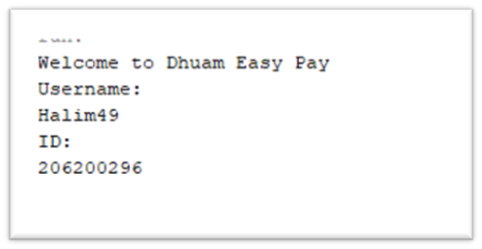
Login
Sample Output
1
User will enter their registered username and ID to access to our payment system

Slide 16
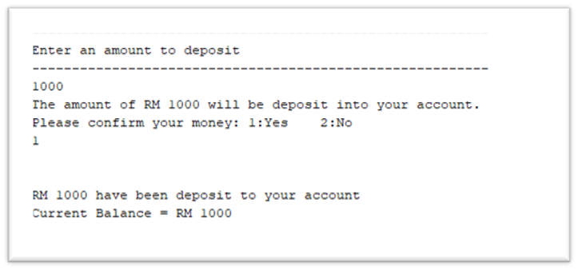
Deposit
Sample Output
2
User will enter the amount of money they want to deposit and the balance will be shown.

Slide 17
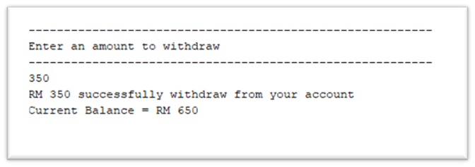
Withdraw
Sample Output
3
User will enter the amount they want to withdraw and current balance will be shown.

Slide 18
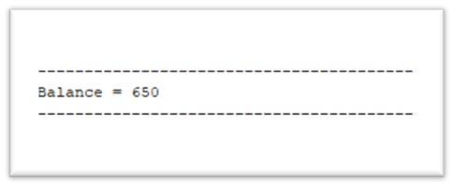
Check Balance
Sample Output
4
When user select option 1, to check balance, it will display the current balance.

Slide 19
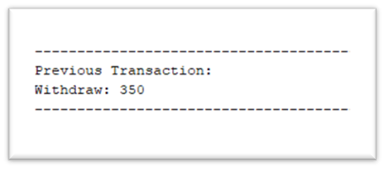
Previous Transaction
Sample Output
5
When the option is selected, the history of transaction will be displayed as transaction record.

Slide 20

Exit System
Sample Output
5
When user select option to exit system, user will get exit message as feedback to our service,

Slide 21

Conclusion
DHUAM Easy Pay is an innovative solution to the challenges faced by DRB-HICOM University students when it comes to withdrawing and depositing money at ATM machines. students no longer have to deal with the difficulties associated with money transactions,

Slide 22
Future Improvements
Better design
Flexible transaction
payWave
More colorful interface with an aesthetic design.
Online platform for users to conduct online transactions
Associated with a sensor ID function that enables payWave transaction

Slide 23
Thank you
From Aliff Iskandar & Rusyaidi Aminin

